Slide 1
LL3 section 75
Multipole moments

Slide 2

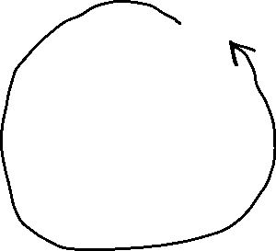














Slide 6


Slide 7


Slide 8




























Slide 9











































Slide 10















































